Slide 1

SCET-MITWPU Depression Detection in humans using Machine Learning Machine Learning and Web development
Team member Details:
SR NO. | NAME | ROLL NO. | PRN | PANEL
1. | Aryan Bansal | 25 | 1032211329 | B
2. | Aerth saraogi | 21 | 1032211208 | B
3. | Akshit Singh | 30 | 1032211401 | B
4. | Sai Venktesh Dubey | 33 | 1032211476 | B
Name of BTech Capstone Project Guide : Mrs. Laxmi Bhagwat
Is the project inhouse/industry sponsored : In House
Number of Time Students met the Project Guide :3
Are the slides approved by Project Guide YES/NO:YES

Slide 2
Literature Survey
The literature review for the "Depression Detection System using Python" outlines several key studies focused on depression detection using machine learning and artificial intelligence. Various methodologies, such as deep learning, neural networks, and natural language processing (NLP), are highlighted for identifying depression through both linguistic and physiological data, such as facial expressions. Research gaps include class imbalance, limited integration of real-time data, and emotion detection accuracy in diverse conditions. Future studies emphasize improving fairness, accuracy, and real-time detection through advanced models. This project aims to bridge these gaps by integrating a diagnostic quiz using a Naive Bayes classifier and real-time facial expression analysis through a Convolutional Neural Network (CNN), combining psychological and physiological data for enhanced diagnosis​

Slide 3
Research Gaps
Following are some research Gaps observed during literature review:
1.Lack of Real-Time Data: Most systems rely on static datasets and lack real-time physiological data, such as facial expressions.
2. Emotion Recognition Challenges: Current models struggle with accurately identifying emotions in diverse conditions.
3. Bias and Fairness: Many models lack fairness and often exhibit bias, with limited ability to explain results.
4.Limited Integration: Few studies effectively combine psychological assessments with physiological indicators like facial expressions for a more comprehensive diagnosis.

Slide 4
Problem Statement
This project aims to address these gaps by developing a Depression Detection System that integrates a diagnostic quiz with real-time facial expression analysis. The system will use a classifier for quiz-based depression detection and a Convolutional Neural Network (CNN) for real-time emotion recognition.
The objectives of Solution are:
1. Incorporate Real-Time Data through facial expression analysis.
2. Enhance Emotion Detection Accuracy using CNN models.
3. Ensure Fairness and Reliability by providing a more comprehensive diagnostic tool that combines psychological and physiological data

Slide 5
Requirements Gathering
Non-Functional Requirements Usability: Intuitive user interface for all technical expertise levels Performance: Efficient real-time facial expression analysis. Scalability: Accommodate a large user base with quick responses. Security: Secure storage and processing of user data. Functional Requirements Quiz Module Diagnostic quiz with multiple-choice questions. Naive Bayes classifier for depression type assessment. Recommendations for clinics and experts. Interactive map for treatment facility location. | Facial expression analysis Module Users record a one-minute video or photo about themselves. CNN analyses facial expressions for emotional evaluation. Real-time data processing for refined diagnosis. Frontend-Backend Integration Seamless interface with HTML, CSS, JavaScript frontend. User data stored in a MongoDB database. Robust handling of quiz and emotion recognition errors. Hardware Requirements High-Performance GPU (e.g., NVIDIA RTX 3090) Microphone and camera for real-time capture. High-capacity SSD storage.

Slide 6
Requirements Gathering
Software Requirements
Backend Processing
Python with FASTAPI
NodeJS with JavaScript
Frontend Development
HTML,CSS,JS
Bootstrap & ReactJS
Machine Learning Libraries & Algorithms
Libraries: OpenCV,Keras,Scikit-Learn,Tensorflow
Algorithms: Naïve Bayes Algorithm, Convolutional Neural Network(CNN)

Slide 7
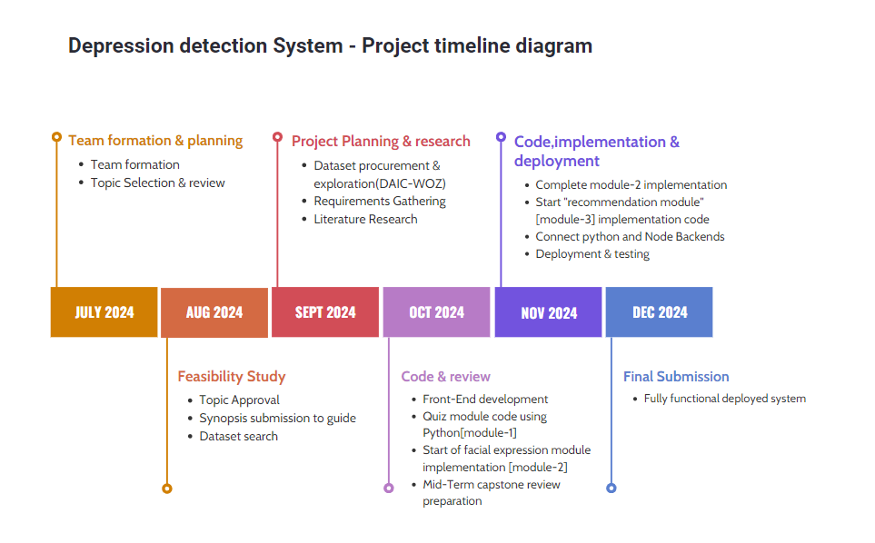
Project Timeline Diagram

Slide 8
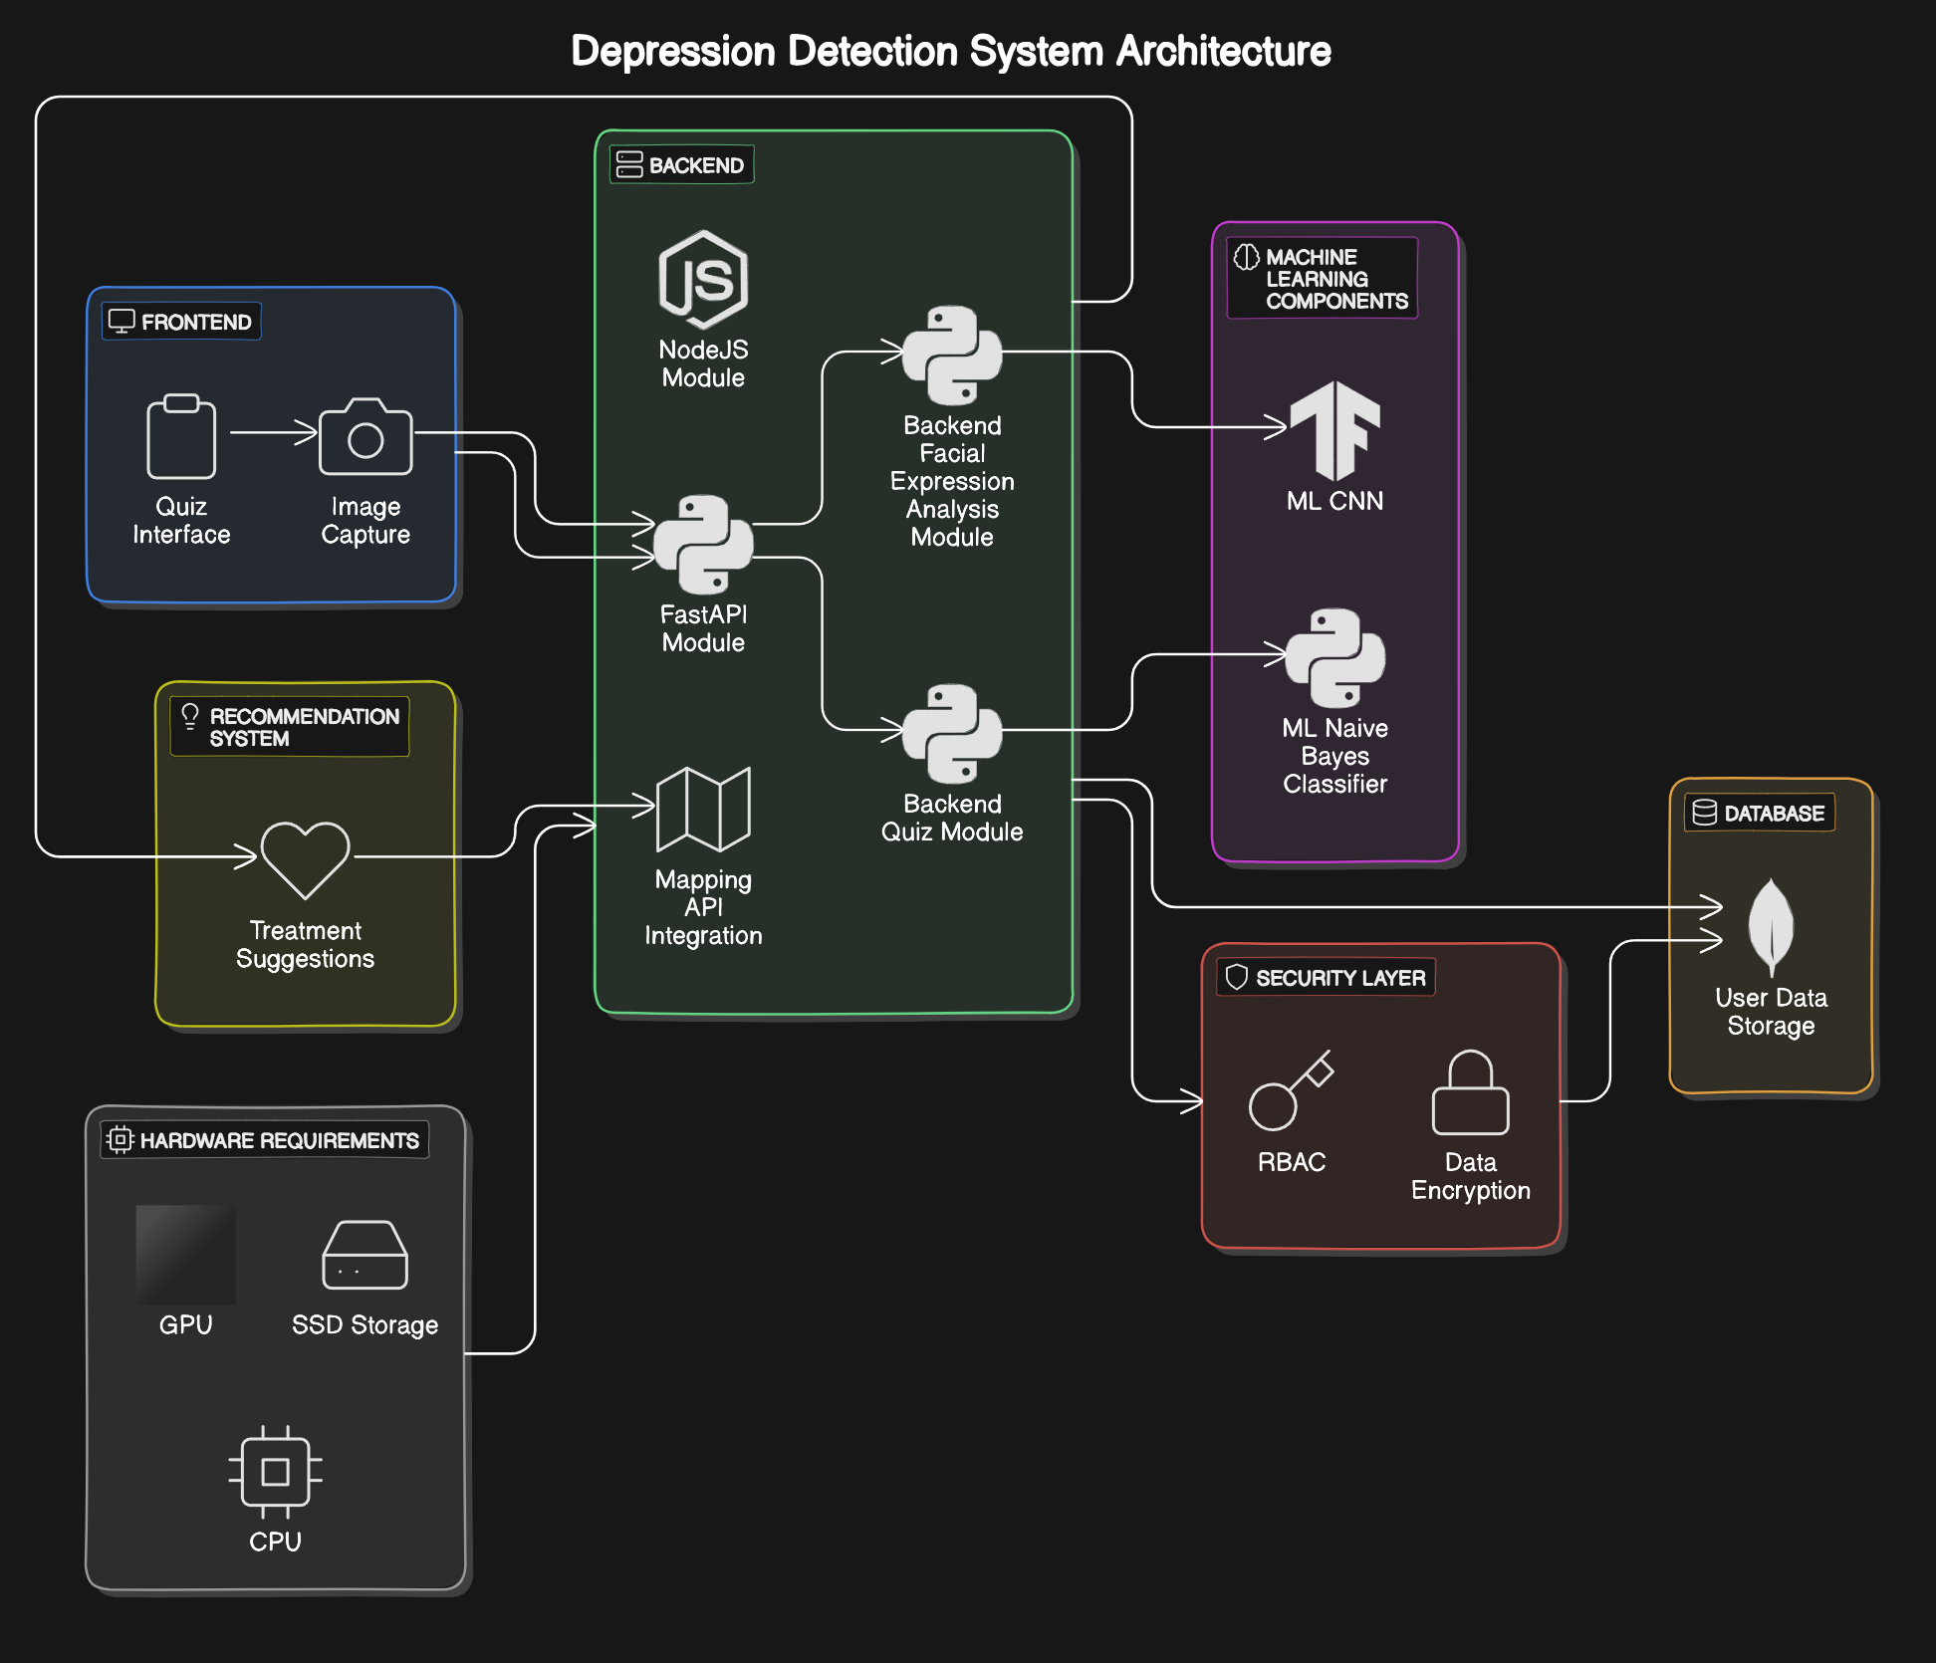
System Design [ Entire system] - Team Approach
UML diagram for depicting System Design-
System-architecture diagram High-level

Slide 9
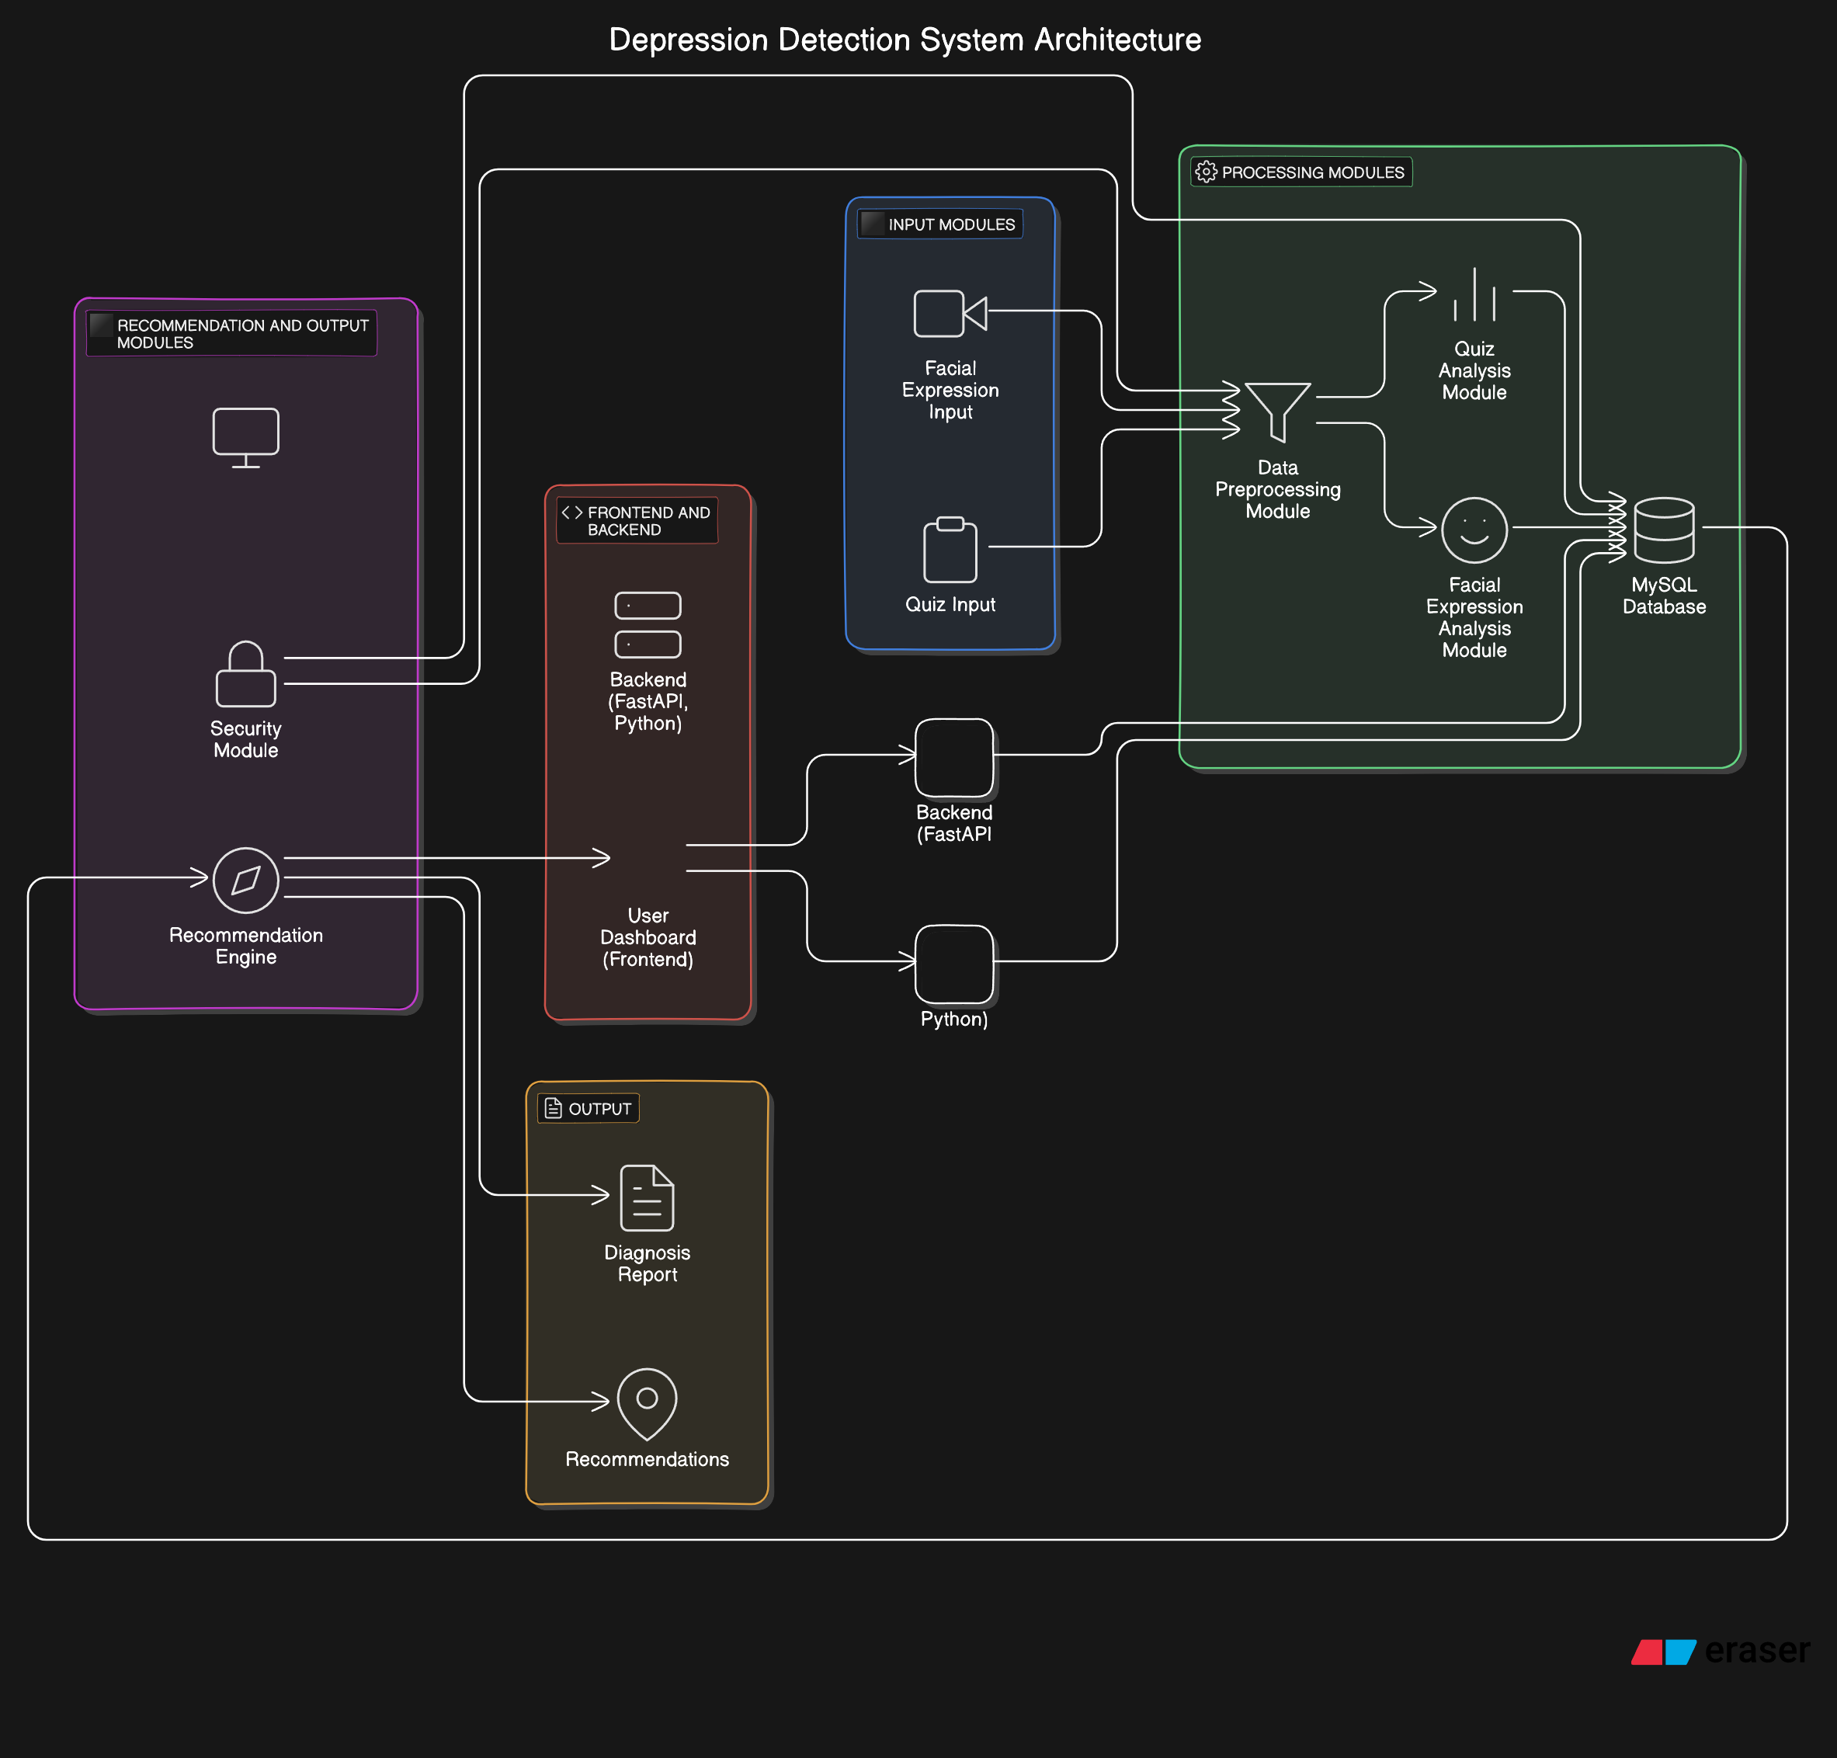
System Design [ Entire system] - Team Approach
UML diagram for depicting System Design-
System-architecture diagram low-level

Slide 10
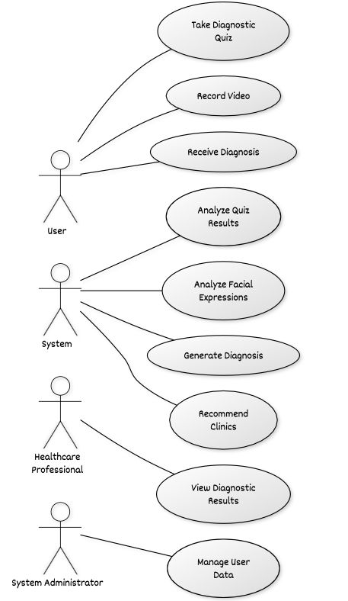
System Design [ Entire system] - Team Approach
2. Use-case Diagram

Slide 11
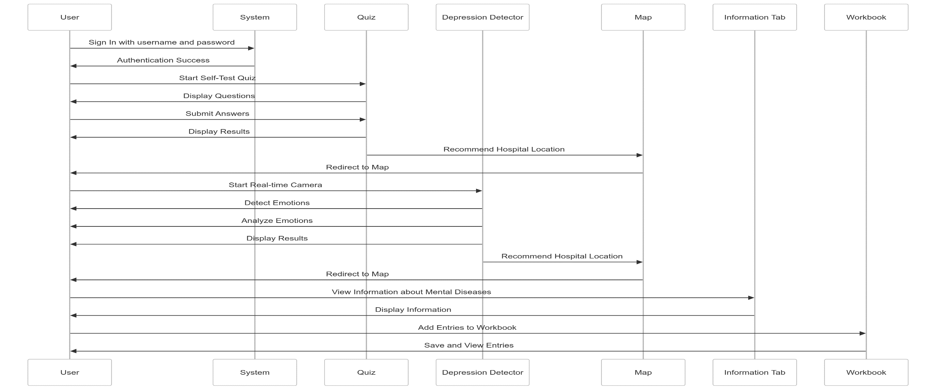
System Design [ Entire system] - Team Approach
3. Sequence diagram

Slide 12
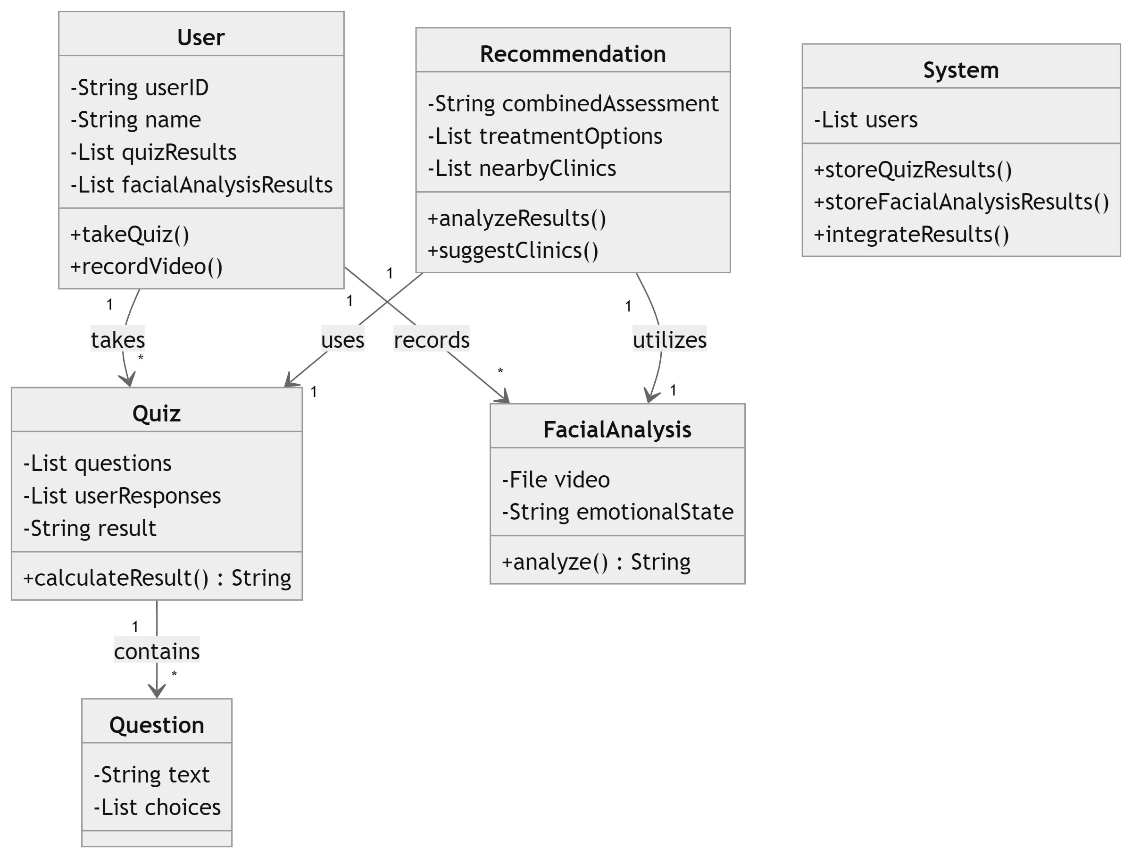
System Design [ Entire system] - Team Approach
3. Class diagram

Slide 13
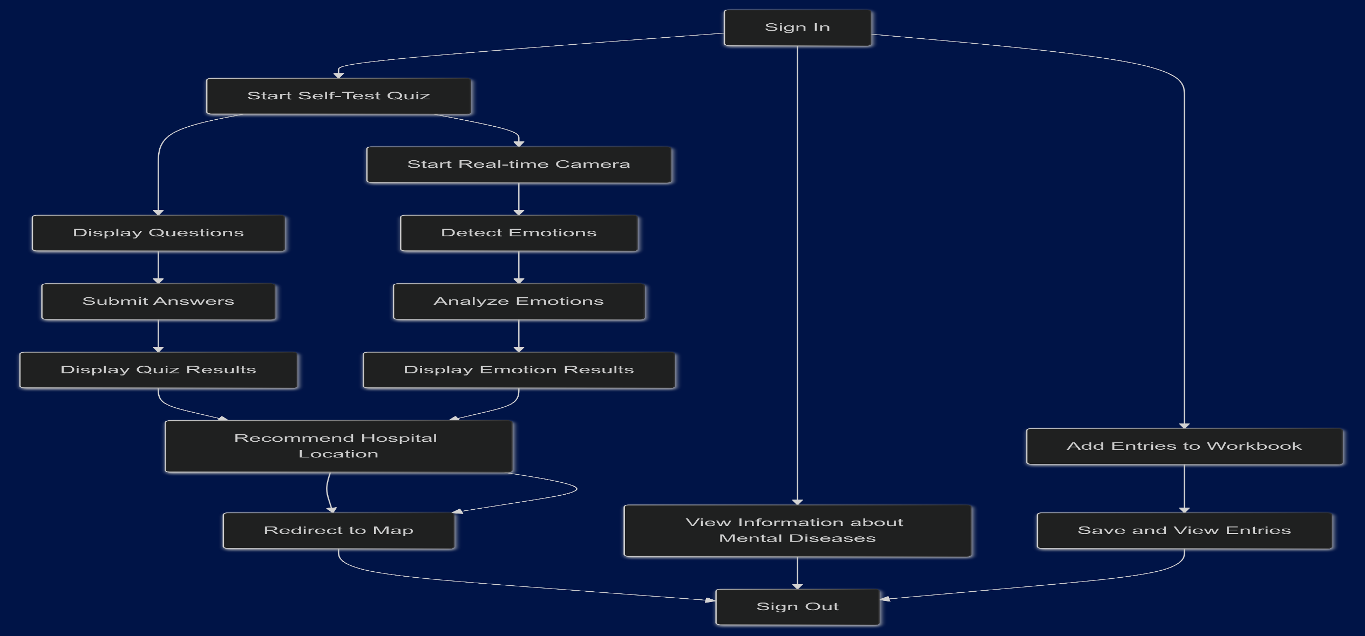
System Design [ Entire system] - Team Approach
3. Activity diagram

Slide 14
System Modules
1. Quiz Module [Module-1]:
- A diagnostic quiz using a Naive Bayes classifier to assess depression types (anxiety, PTSD, bipolar disorder) based on user responses. It provides treatment recommendations and resources.
2. Facial Expression Analysis Module [Module-2]:
- Uses a CNN to analyze users' facial expressions from a one-minute video, detecting emotional states to refine the diagnosis.
3. Recommendation Module [Module-3]:
- Combines quiz and facial analysis results to suggest nearby clinics and psychiatrists, along with tailored treatment options, displayed on an interactive map.

Slide 15
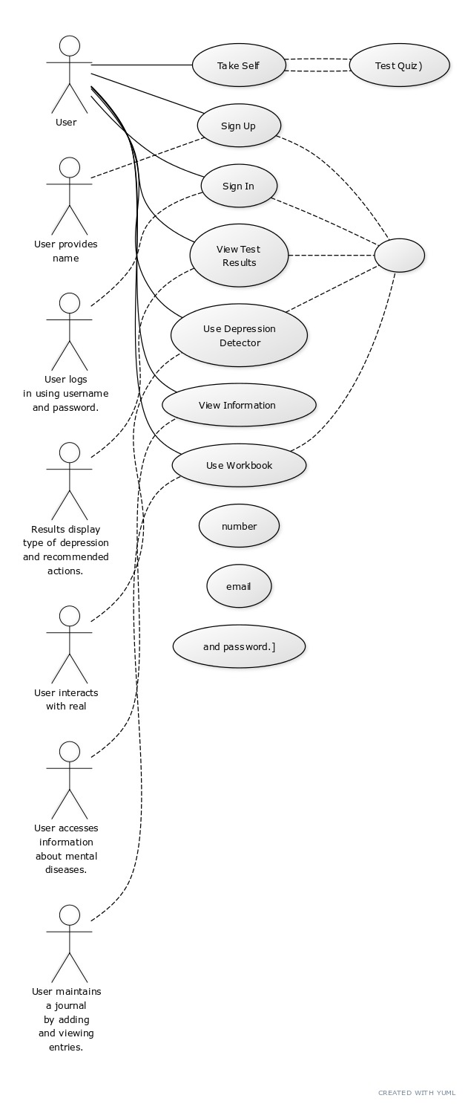
System Design – Quiz Module
1. Use-case diagram

Slide 16
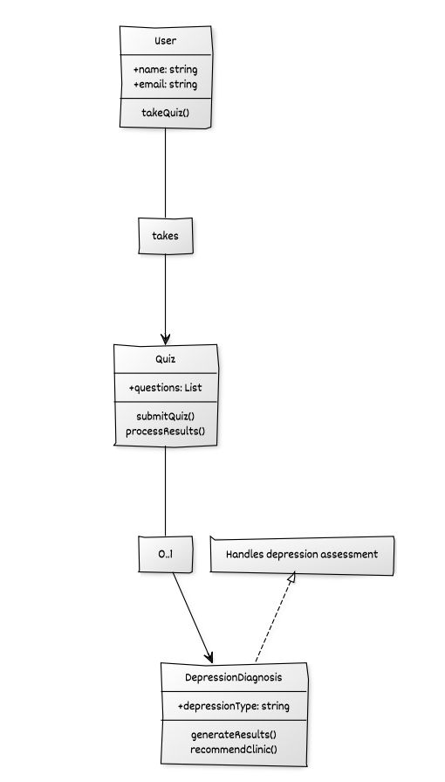
System Design – Quiz Module
2. Class diagram

Slide 17
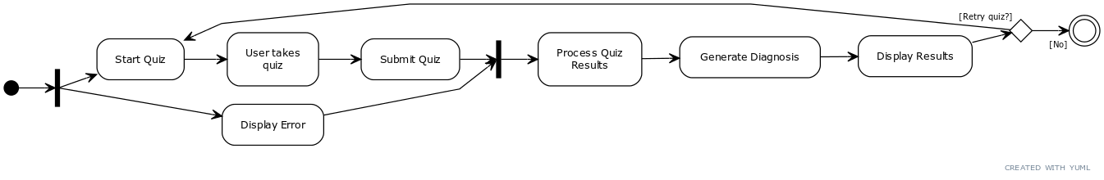
System Design – Quiz Module
3. Activity diagram

Slide 18
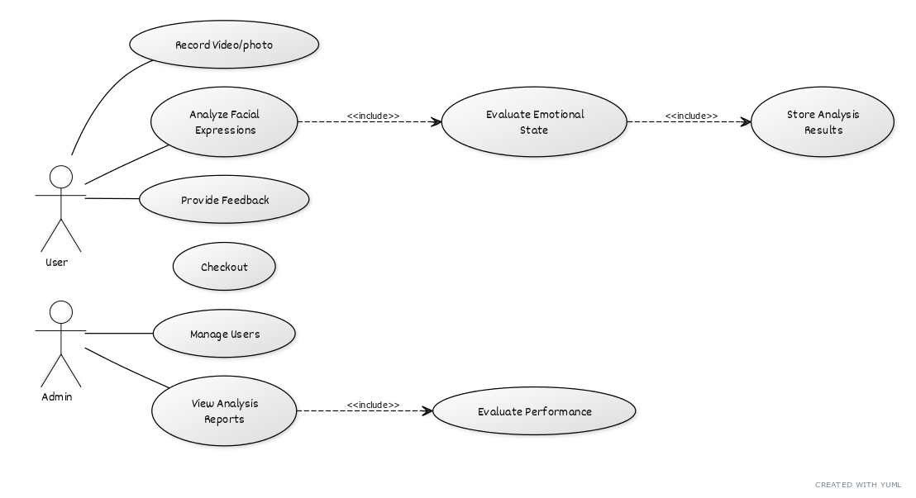
System Design – Facial expression Module
1. Use-case diagram

Slide 19
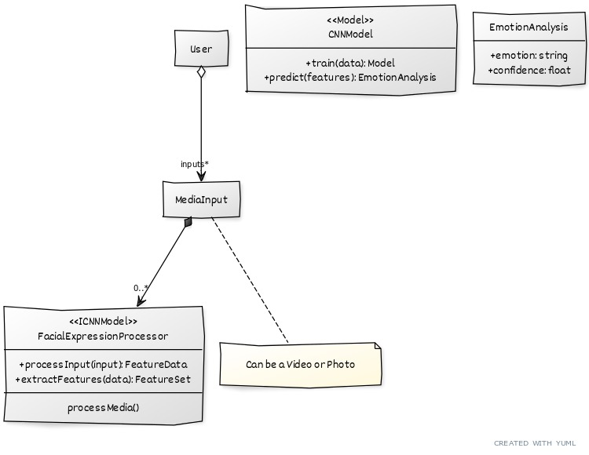
System Design – Facial expression Module
2. Class diagram

Slide 20
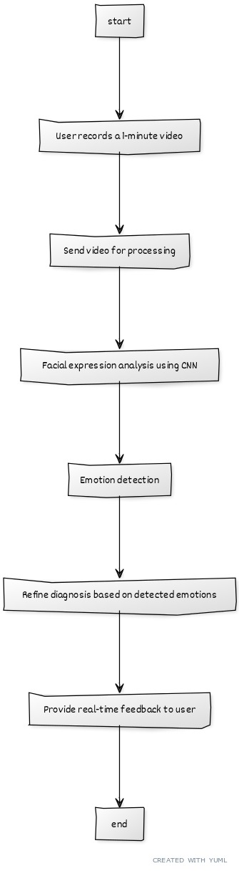
System Design – Facial expression Module
3. Activity diagram

Slide 21
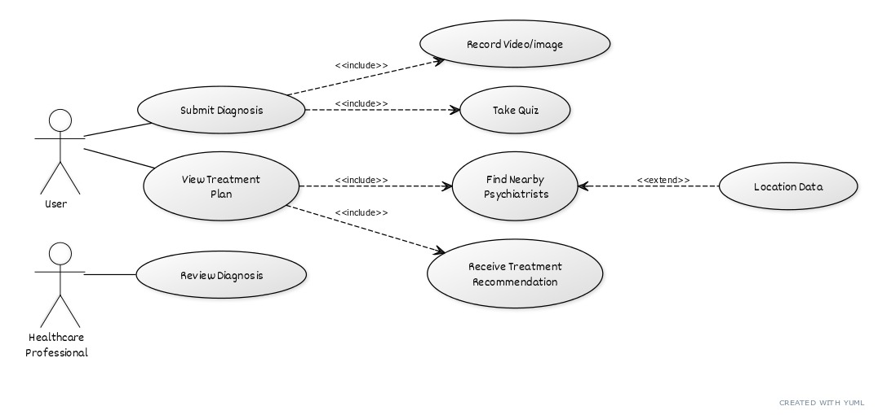
System Design – Recommendation Module
1. Use-case diagram

Slide 22
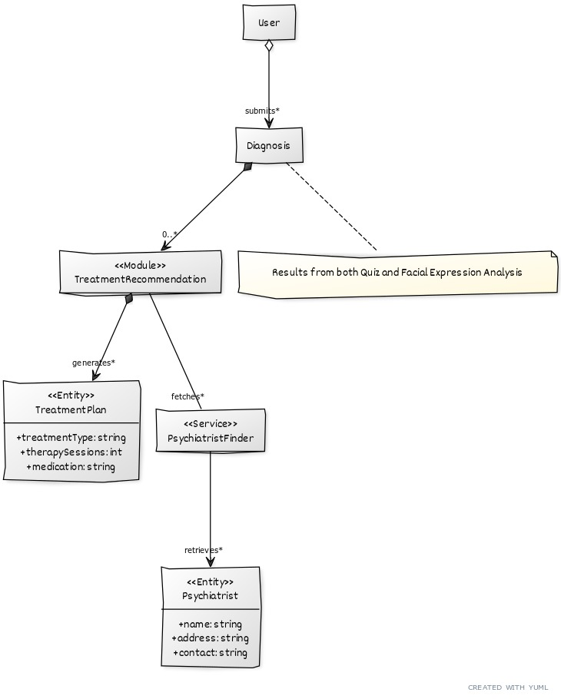
System Design – Recommendation Module
2. Class diagram

Slide 23
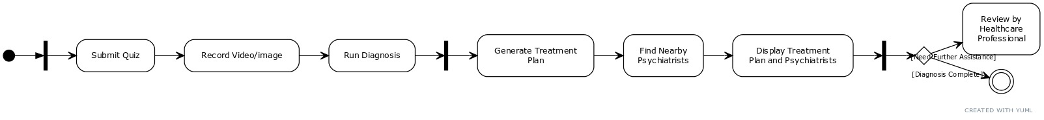
System Design – Recommendation Module
3. Activity diagram

Slide 24
Dependency of Modules
Quiz → Recommendation: Quiz results provide the foundation for personalized treatment recommendations.
Facial Expression Analysis → Recommendation: Refines diagnosis for more accurate suggestions.
Recommendation Module: Relies on combined inputs from Quiz and Facial Analysis to suggest clinics and treatments
All of them are dependent upon the inputs received from user through quiz inputs and video/image.

Slide 25


Current implementation snapshots

Slide 26
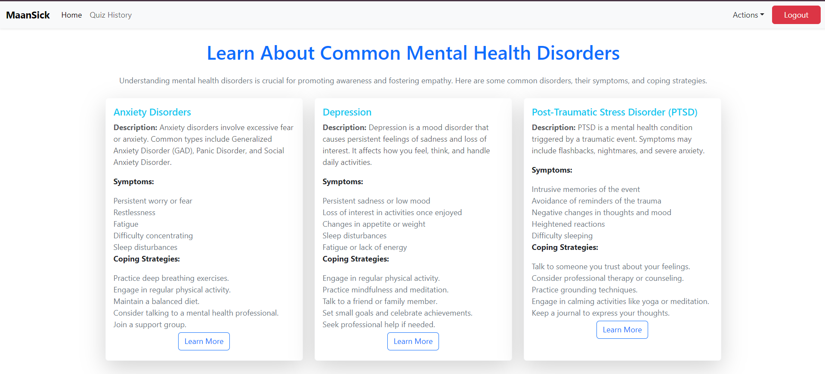
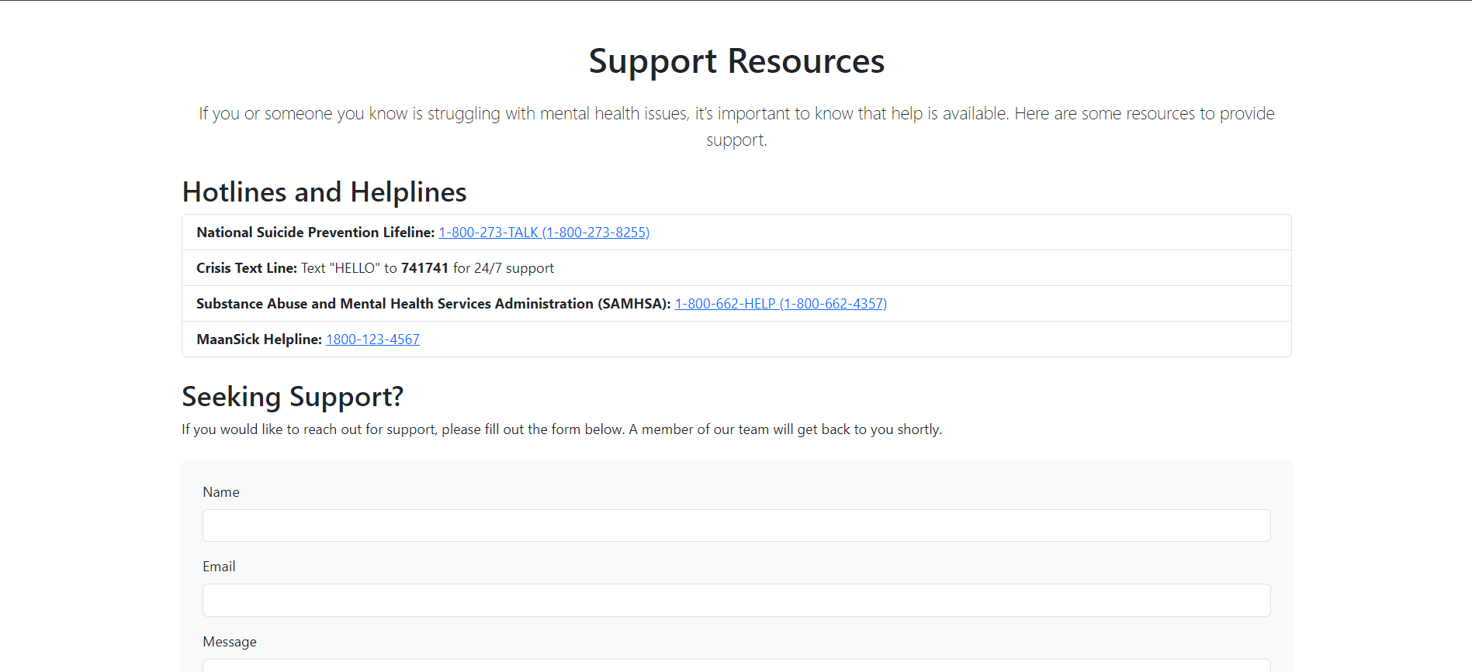
Current implementation snapshots

Slide 27
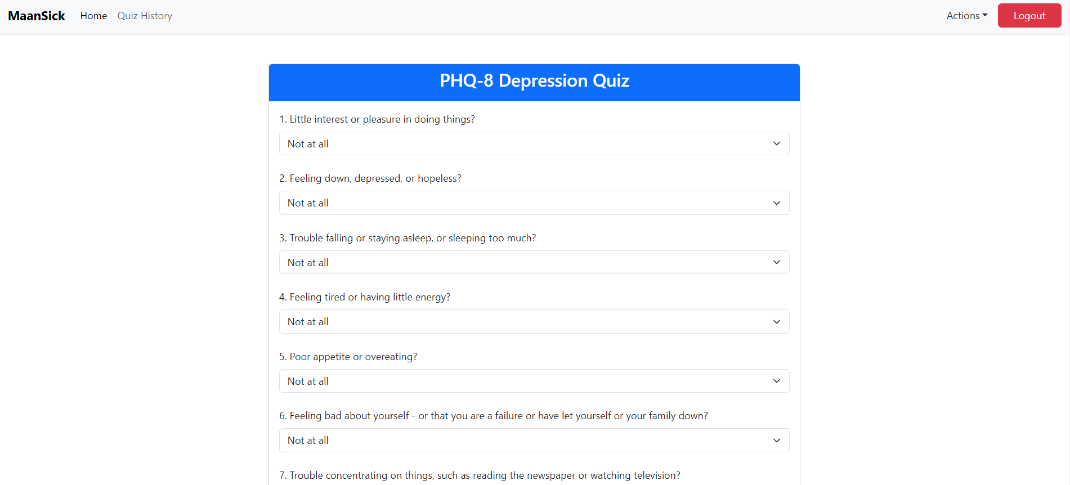
Current implementation snapshots

Slide 28
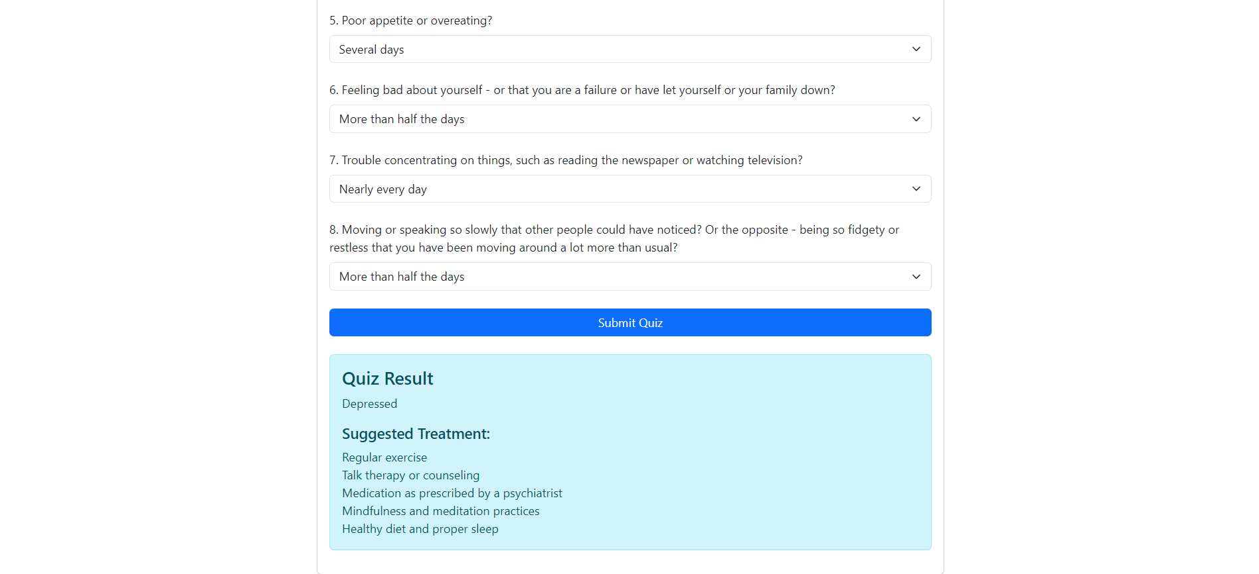
Current implementation snapshots

Slide 29
Future Aspects
Future Integrations
We may use the more advanced models for our tasks or we aim to optimize the current processes but identifying more robust techniques.
Testing Strategies
Unit testing for Naive Bayes, CNN, and preprocessing tasks.
Integration testing for smooth frontend-backend interactions and accurate real-time processing.
User and performance testing for real-time emotion detection, ensuring scalability and low latency.

Slide 30
Future Aspects
Deployment Strategies
Start with local deployment for testing.
Cloud deployment on AWS/Heroku with Docker for scalability.
Ensure data security with encryption, authentication, and role-based access control (RBAC).

Slide 31
Publication details
Details on Literature Review Paper
The review paper titled "Depression Detection System using Python" examines traditional methods like the PHQ-9 questionnaire, which lack real-time capabilities and emotional analysis. It highlights technological gaps in existing models, such as challenges with class imbalance and accuracy in emotion detection. The paper emphasizes the potential of integrating Convolutional Neural Networks (CNNs) for facial expression analysis and Naive Bayes for quiz-based assessments in automated depression detection. Future improvements in data processing and the integration of psychological and physiological data are recommended to enhance detection accuracy. Ultimately, the paper advocates for a combined approach using quizzes and real-time facial analysis for more effective depression detection.

Slide 32
Publication details
Details of Future planning for Implementation Paper
The implementation plan for the Depression Detection System includes several key stages. Initially, the focus will be on integrating the Naive Bayes classifier for quiz assessments and the Convolutional Neural Network (CNN) for facial expression analysis using FastAPI for seamless frontend-backend communication. Next, real-time facial analysis will be implemented to provide immediate feedback. The user interface will be developed with ReactJS for a user-friendly experience, while data management will utilize MySQL/MongoDB to ensure secure storage and privacy. Testing will encompass unit, integration, and user testing, followed by deployment on cloud platforms for scalability. Future enhancements may include integrating wearable health device data and expanding diagnostic capabilities.

Slide 33


